Slide 1
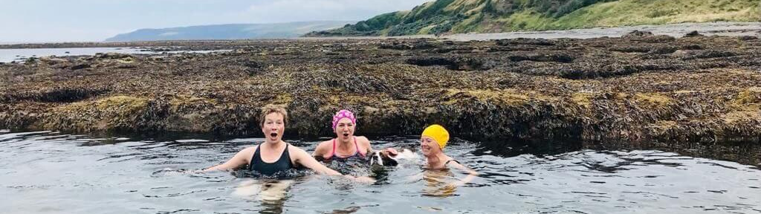
VISION & MISSION
VISION
MISSION
A Scotland where women and girls have equal opportunities to thrive in all areas of sport.
We will advocate for change, elevate voices and enable growth for Scottish women and girls in sport.

Slide 2
OUR 3 PILLARS
advocate
celebrate
grow

Slide 3
Advocate
Host and deliver an annual conference to highlight relevant work
Endorse and promote relevant external campaigns and create internal campaigns
Enhance the profiles of women in sport to promote change (e.g. written, online, in-person events, broadcast/media)

Slide 4
Celebrate
Celebrate the achievements of Scottish women and girls in sport through hosting and delivering an annual awards dinner
Celebrate our partnerships by strengthening relationships and working collaboratively with sports organisations
Raise the visibility of our organisation and Scottish women and girls in sport through SW/S social channels

Slide 5
Grow
Create a research and resources area on website with reference to relevant bodies
Create a community network for women and girls in sport to connect, share and support
Collaborate and work in partnership with male allies

